Slide 1
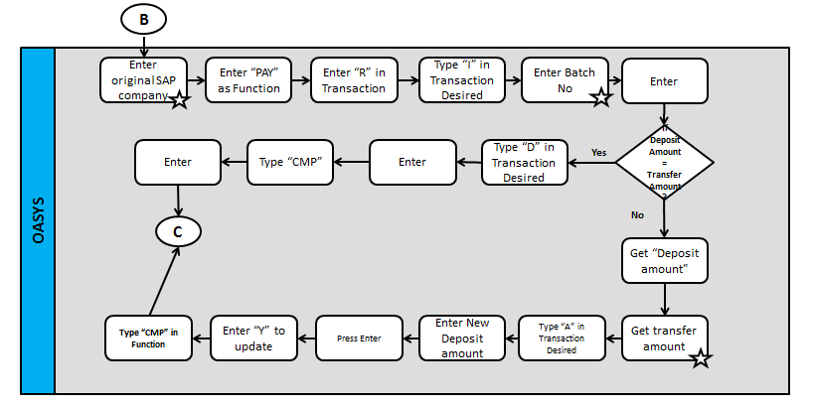
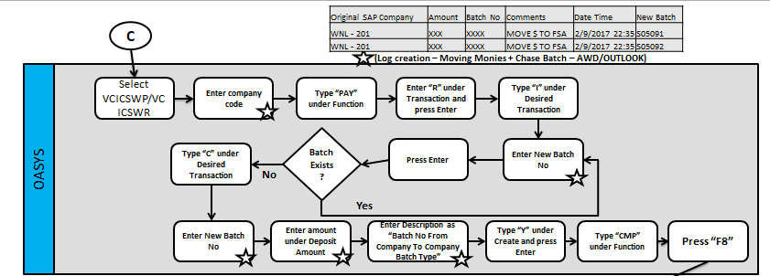
OASYS – Chase Batch Creation + Moving Monies
1

Slide 2
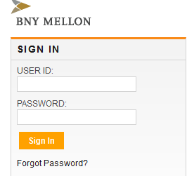
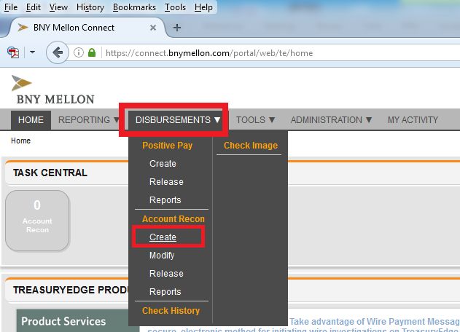
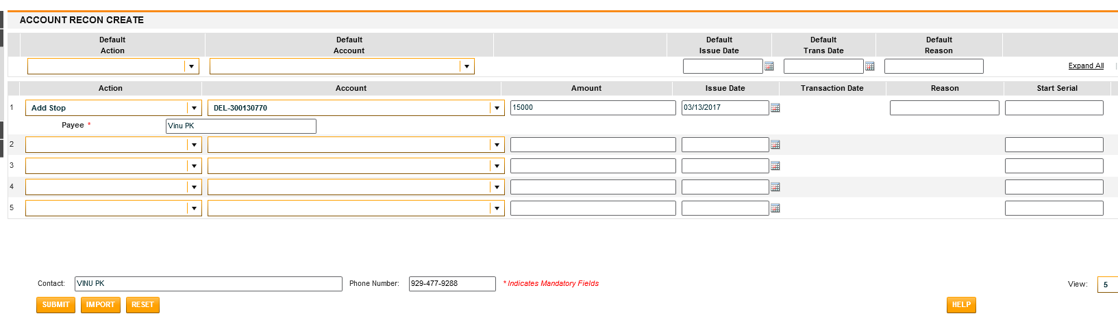
BONY Mellon Process Map
Use SAP and other applications for check status update
N
Input
Email
WE
AWD
If Check to be stopped?
Login to BONY
Go to “Disbursement”- click on “Create”
Next screen- update the below based on the input pdf file from SME as below
Y
*In the future State All the above Steps would be done by ROBOT
Action – ‘Add Stop’ this information can be driven from SAP t-code fch8 data
Account: XXXXXX770 for Company code L001, XXXXX788 for L051
Payee Name: as per the input file
Amount: as per the input file
Issue Date: As per the input file
Reason: as per the input file
Start Serial: Check Number as per the input file.
Phone Number: office land phone number
Click on “Submit” Button

Slide 3
Scope / Solution Documents
Chase Batch Creation + Moving Monies
Stop Pay & Void Pay Amarillo
3

